Slide 1
Open Science Week
Université Paris-Saclay, 4-8 novembre 2024
Projet ACTIVATE
MSCA Staff Exchanges
2025-2028
The ACtivist, the archivist and the researcher:
novel collaborative strategies of Transnational research, archIVing and exhibiting
sociAl and poliTical dissent in Europe (19th -21st century)
Caroline Moine (CHCSC, UVSQ/Paris-Saclay)
caroline.moine@uvsq.fr

Slide 2
1 - Objectives

Slide 3
The project aspires to define the role and importance of collecting, archiving and promoting documents, objects and data in order to contribute to a renewed European history of social and political dissent from the beginning of the 19th century to the present day

Slide 4
4 key transversal themes
to study these different forms of dissent in an international, comparative perspective
Progressive and conservative revolutionary movements
Feminist movements
Environmental struggles
Social and political solidarity with extra-European causes.

Slide 5
Based on archives and collections in museum
private, non-state and community archives
located in Europe
with strong commitment to civic engagement and public activities
The archives as institutions and actors of European history from the 19th century to the present day - and not only as resources for researchers

Slide 6
Main goals
To link scientific reflection on the multiple forms of commitment and protest in a multidisciplinary perspective with epistemological reflection on the function of archives;
to examine the challenges of training in these research areas;
to propose new forms of display and communication about political and social protest in Europe from the 19th century onwards
= 242 months of mobility/secondment

Slide 7
2- The network

Slide 8
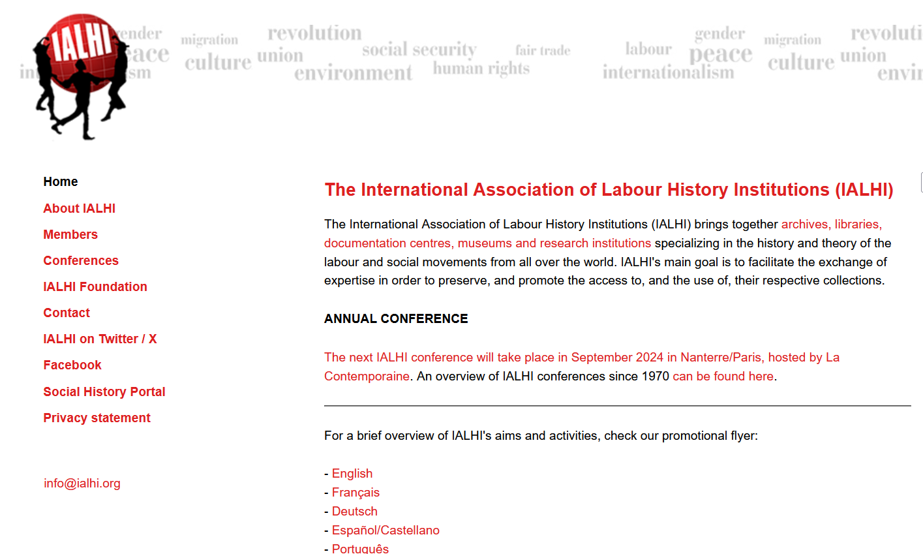
The metis network
The IALHI network
https://wp.unil.ch/metis/presentations-des-centres/

Slide 9
16 partners from 7 European countries
FRANCE UVSQ; La contemporaine; Centre Audiovisuel Simone de Beauvoir; Musée Carnavalet
GERMANY FU Berlin; FES (AdsD)
HUNGARY Blinken OSA Archivum/CEU
ITALY UNIPD; UNIBO; Fondazione Feltrinelli; Fondazione Gramsci Emilia-Romagna
NETHERLANDS IISG
POLAND KARTA
SWITZERLAND UNIL; Cinémathèque suisse; Sozialarchiv

Slide 10
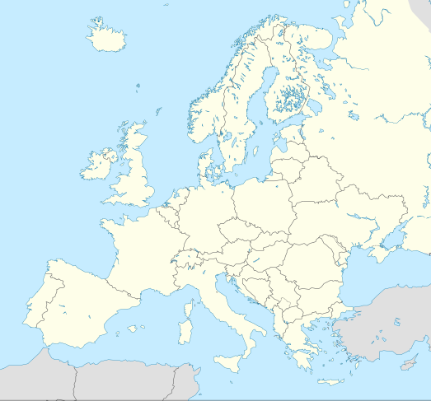
FU
IISG
FES
UVSQ
La contemporaine
KARTA
Musée Carnavalet
CASdB
Blinken OSA Archivum
UNIL
UNIPD
Sozialarchiv
UNIBO
Cinémathèque
suisse
FGF
IGER

Slide 11
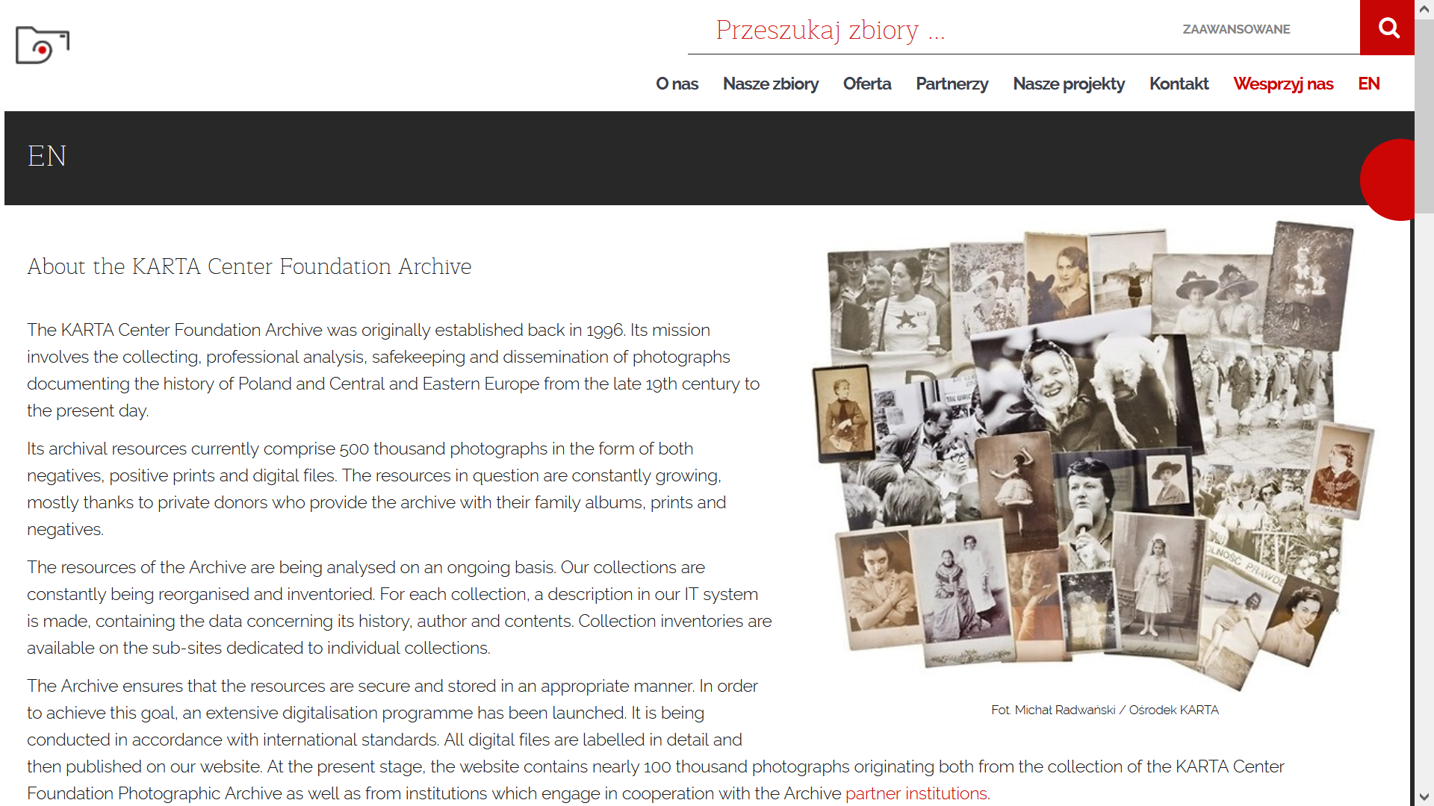
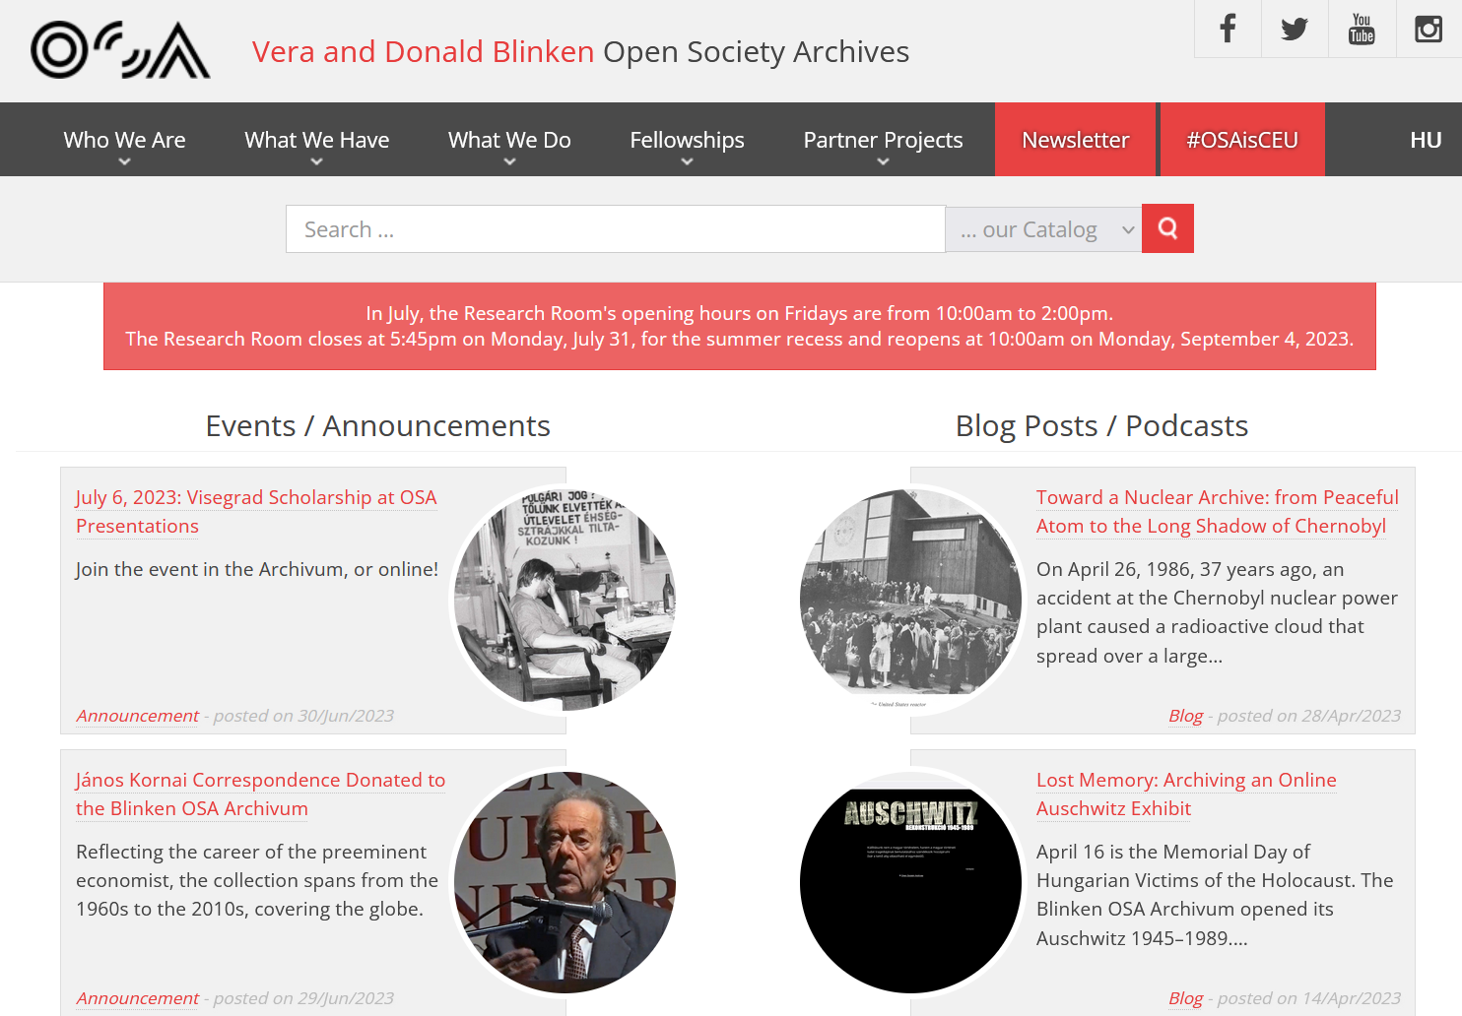
POLAND
HUNGARY
KARTA Center Foundation (Warsaw)
Blinken OSA Archivum (Budapest)

Slide 12
3 – Three axes

Slide 13
Activating Archives : a comparative transnational history
To place the collection’s history of the partners in a wider context of protest
To see to what extent each institution has developed and evolved in relation to others.
How?
Conducting interviews with activists and archivists,
Retracing this history in a comparative and chronological perspective
Discussing the gaps in the collections

Slide 14
Material Culture in Social and Political Mobilisation
A better definition of political materiality over time
New reflections and practices on archiving, cataloguing and exhibiting political objects
The mobility of objects in space and time

Slide 15
Alternative media and digital activism
How alternative social and media archives preserve and transmit the representation of political dissent through activist media practices in historical and comparative perspectives
Including various types of media
How?
Mapping multi-media archival collections
Promoting a collective historical reflection on the notion of ‘mediactivism’
Developping cross-disciplinary collaboration between archivists and researchers on the issue of web activism

Slide 16
4- Various forms of dissemination

Slide 17
Scientific international Publications
Workshops & Summer Schools
Scientific Conferences
Seminars
Podcasts
Digital Exhibition
Live Exhibition
OER

Slide 18
Open Educational Resources (OER)
Learning, teaching, and research materials in any format and medium, in the public domain or protected by copyright and published under an open license, which authorize their free consultation, reuse, use for other purposes, adaptation and redistribution by others.

Slide 19
Challenges for ACTIVATE
-research / archival training
-who will produce the OER?
-moving from a national to a European framework
-which language(s)?
-which platform?

Slide 20
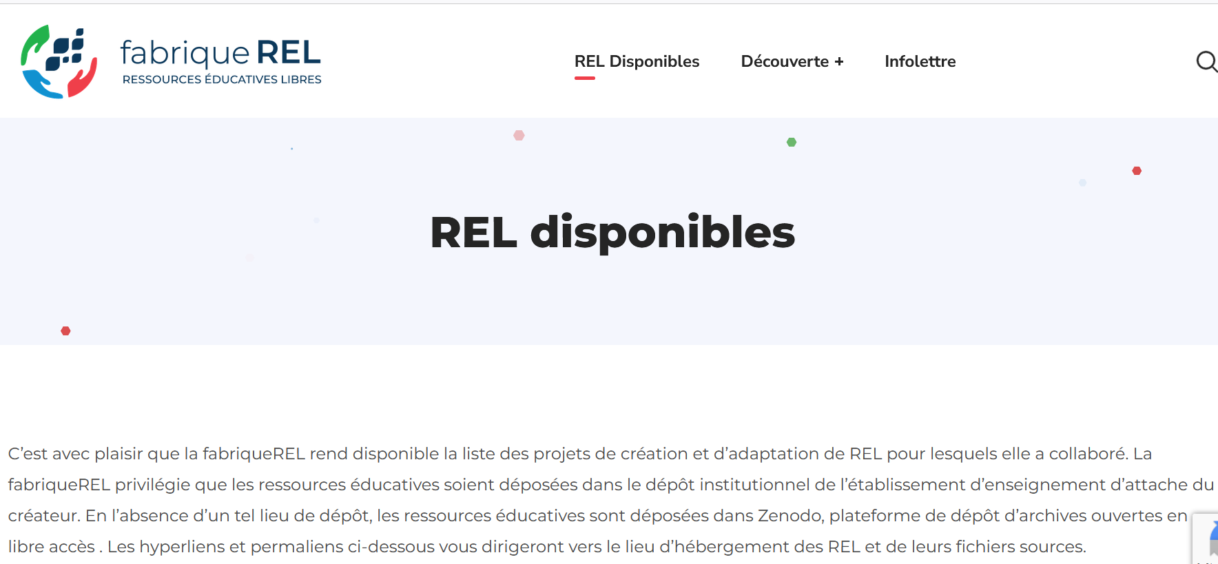
https://fabriquerel.org/rel-disponibles/

Slide 21
More to come!....

